Slide 1
NetAcad Modules 3-7 Review

Slide 2
IP Addressing
3
ITN Chapter 7

Slide 3
IP Terminology
Dotted-decimal notation: an IP address written in 4 octets in decimal format
Binary: base 2 number system of 0s and 1s
Octet: a group of 8 binary digits
Network portion: bits of the IP address that identify the subnet
Host portion: bits of the IP address that identify individual nodes
Subnet mask: used to identify the network and host portions of an address
Prefix length: (also known as slash or CIDR notation) the number of 1s in the binary form of the subnet mask

Slide 4
Addressing Terminology
Static IP address: an IP address manually managed by an administrator or user
Dynamic IP address: an IP address automatically managed by a server
Unicast: communication between two individual devices
Multicast: a message sent from one device to a group of devices
Broadcast: a message sent from one device to all listening devices
Public address: can be used globally
Private address: can only be used within an internal network

Slide 5
Private Addresses
10.0.0.0/8
or 10.0.0.0 to 10.255.255.255
172.16.0.0/12
or 172.16.0.0 to 172.31.255.255
192.168.0.0/16
or 192.168.0.0 to 192.168.255.255

Slide 6
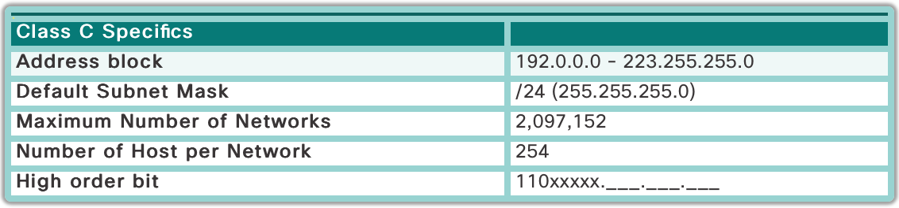
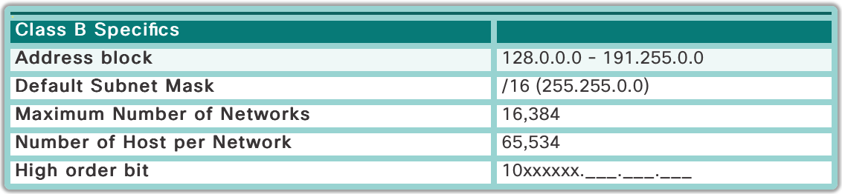
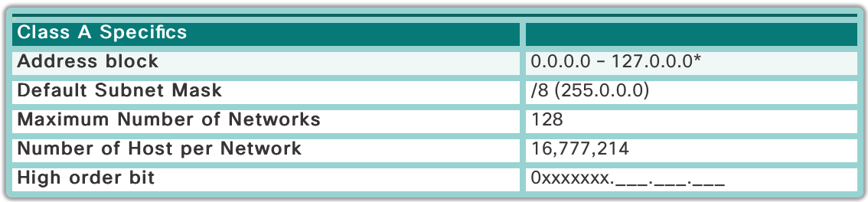
Classful Addressing
Legacy addressing where networks are assigned a network address in a class with a predefined allowed number of hosts
Replaced with CIDR addressing to allow for less waste in address allocation

Slide 7
Subnetting IP Networks
4
ITN Chapter 8

Slide 8
Subnetting Terminology
Subnet: section of a network
Broadcast domain: group of devices that can receive a broadcast from one another; usually all connected by layer 2 switches in one subnet
Octet boundary: subnet created using a /8, /16, or /24 subnet mask
VLSM: (Variable Length Subnet Mask) dividing a network into subnets of different sizes in order to conserve address space

Slide 9
Planning a Network
Broadcast domains must remain manageable
Must leave enough possible subnets for future expansion
Each subnet must have enough possible host addresses for future expansion
/24 is the most common subnet boundary as it allows for many different subnets with up to 254 hosts
Most devices should have a dynamically allocated IP, whereas servers and network devices should have a static IP
Conserving address space is not much of a concern in IPv6, so networks do not need as detailed planning as IPv4

Slide 10
Classless Subnetting
Bits are “borrowed” from the host portions to create subnets of the original network
Ex. 192.168.0.0/16 is the network address and 8 bits are borrowed via a /24 subnet mask
There can be 254 subnets with 254 hosts each
One subnet could be 192.168.10.0 and a host on that subnet could be 192.168.10.1
Broadcast address of that subnet is 192.168.10.255
Subnets should be chosen based on the number of needed hosts to conserve addressing space

Slide 11
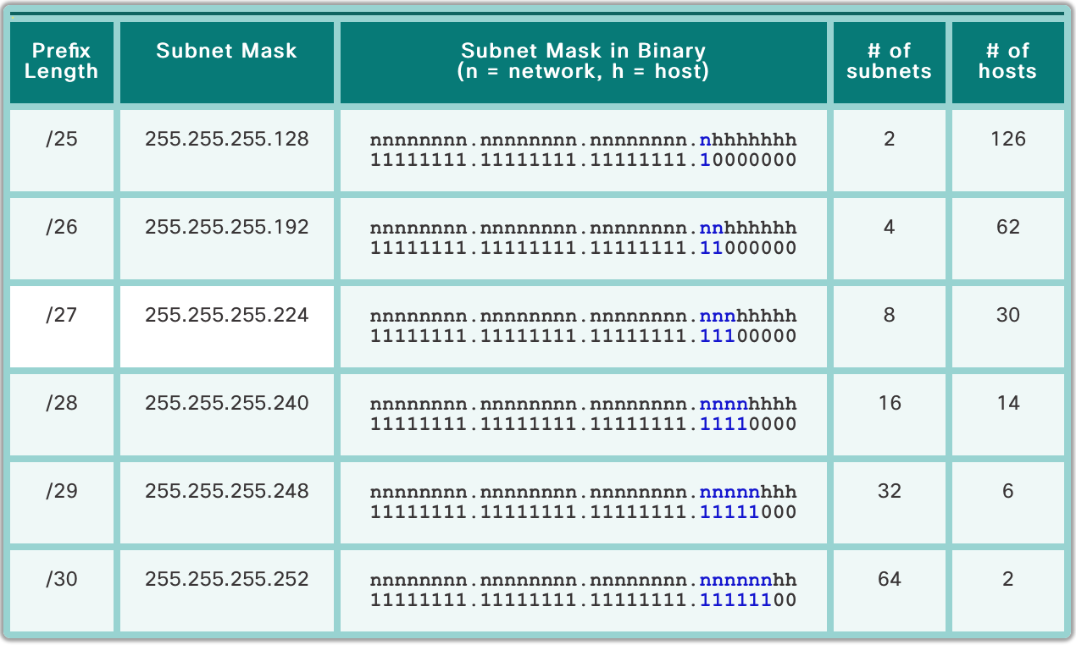
Example Subnets

